Slide 1


Foundations of HTML5 and Document Structure
Presenter: AI Development Team

Slide 2


Content
1. Introduction to HTML5
2. HTML5 Document Structure
3. Semantic Elements in HTML5
4. Practical Application and Best Practices

Slide 3


Section 1
Introduction to HTML5

Slide 4




Overview of HTML5 and Its Importance
Latest HTML Standard
Cross-Device Compatibility
Enhanced Multimedia Support
HTML5 represents the most current version of HTML, incorporating new elements and APIs that enhance the functionality and interactivity of web applications.
Designed to work seamlessly across various devices, HTML5 ensures that websites are accessible and perform consistently on desktops, tablets, and smartphones.
HTML5 natively supports audio and video playback, allowing developers to integrate rich media experiences without the need for external plugins, thus improving user engagement.

Slide 5
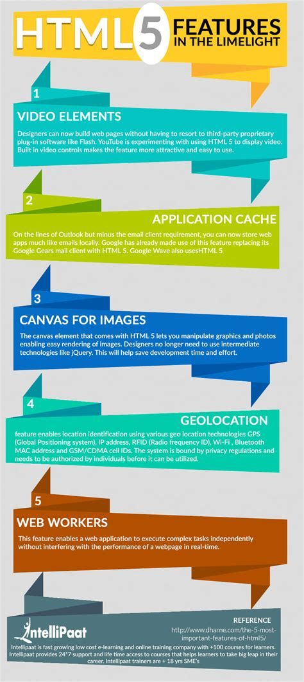
Key Features of HTML5
New Semantic Elements
HTML5 introduces a variety of semantic elements such as <header>, <footer>, <article>, and <section>, which provide a clearer structure to web documents, enhancing both readability and maintainability.
Multimedia Support
With native support for audio and video elements through <audio> and <video> tags, HTML5 allows developers to embed multimedia content directly into web pages without relying on third-party plugins, improving user experience and performance.
Local Storage and Offline Capabilities
HTML5 includes APIs for local storage, enabling web applications to store data on the client side, which allows for offline functionality and improved performance by reducing server requests.

Slide 6



Advantages of Using HTML5
01
02
03
Improved User Experience
Enhanced Accessibility
Cross-Platform Compatibility
HTML5 enhances user experience by providing native support for multimedia elements, allowing seamless integration of audio and video without the need for external plugins, which leads to faster load times and smoother interactions.
The introduction of semantic elements in HTML5 improves accessibility for users with disabilities, as screen readers can better interpret the structure and meaning of web content, making it easier for all users to navigate and understand.
HTML5 is designed to work consistently across various devices and browsers, ensuring that web applications function properly on desktops, tablets, and smartphones, which is crucial for reaching a wider audience in today's mobile-centric world.

Slide 7


Transition from Previous HTML Versions
Evolution of HTML Standards
Deprecation of Obsolete Elements
Increased Focus on Semantics
The transition from earlier HTML versions, such as HTML 4.01 and XHTML, to HTML5 reflects a significant evolution in web standards, focusing on improved functionality, semantic structure, and multimedia support.
HTML5 has deprecated many outdated elements and attributes from previous versions, such as <font> and <center>, promoting the use of CSS for styling and layout, which enhances the separation of content and presentation.
The shift to HTML5 emphasizes the importance of semantic elements, allowing developers to create more meaningful and accessible web content, which benefits both search engine optimization (SEO) and user experience.

Slide 8
Section 2
HTML5 Document Structure

Slide 9
Understanding the Doctype Declaration
01
02
03
Purpose of Doctype
Simplified Syntax
Impact on Rendering
The <!DOCTYPE html> declaration is essential for HTML5 documents as it informs the web browser to render the page in standards mode, ensuring consistent behavior across different browsers and devices.
Unlike previous HTML versions that required complex and lengthy doctype declarations, HTML5 simplifies this to a single line, making it easier for developers to implement and understand the document structure.
The presence of the doctype declaration affects how browsers interpret the HTML document, influencing layout, styling, and functionality, which is crucial for achieving the desired user experience on web pages.

Slide 10

HTML5 Boilerplate Example
Basic Document Structure
An HTML5 boilerplate starts with the <!DOCTYPE html> declaration, followed by the <html> element, which encapsulates the entire document, ensuring proper rendering in browsers.
Essential Meta Tags
The <head> section includes critical meta tags such as <meta charset="UTF-8"> for character encoding and <meta name="viewport" content="width=device-width, initial-scale=1.0"> for responsive design, enhancing accessibility across devices.
Content Organization
The <body> section contains the visible content of the webpage, structured with semantic elements like <h1> for headings and <p> for paragraphs, promoting better SEO and user experience through clear content hierarchy.

Slide 11



Importance of Meta Tags
Defining Document Metadata
Enhancing SEO Performance
Facilitating Responsive Design
Meta tags provide essential information about the HTML document, such as character set, author, and description, which helps browsers and search engines understand the content and context of the page.
Properly utilized meta tags, particularly the <meta name="description"> and <meta name="keywords">, can significantly improve search engine optimization (SEO) by influencing how search engines index and rank the webpage, ultimately driving more traffic.
The viewport meta tag is crucial for responsive web design, allowing developers to control the layout on mobile devices by specifying how the page should scale and adapt to different screen sizes, ensuring a better user experience across devices.

Slide 12
Viewport Settings for Responsive Design
01
02
03
Viewport Meta Tag Importance
Controlling Layout on Mobile
Scaling and Zooming Options
The viewport meta tag, <meta name="viewport" content="width=device-width, initial-scale=1.0">, is essential for responsive design as it instructs browsers on how to adjust the page's dimensions and scaling based on the device's screen size.
By setting the viewport width to device-width, developers ensure that the layout of the webpage fits the screen of the device, preventing horizontal scrolling and enhancing usability on mobile devices.
The initial-scale parameter allows developers to define the initial zoom level when the page is first loaded, providing a better user experience by ensuring that content is legible and accessible without requiring users to zoom in manually.

Slide 13
Section 3
Semantic Elements in HTML5

Slide 14
Introduction to Semantic Elements
Definition of Semantic Elements
Semantic elements in HTML5 are tags that convey meaning about the content they enclose, such as <header>, <footer>, <article>, and <section>, providing a clearer structure to web documents.
Significance for Accessibility
By using semantic elements, developers enhance accessibility for users with disabilities, as screen readers can interpret the document structure more effectively, allowing for a better navigation experience.
Impact on SEO
Semantic elements improve search engine optimization (SEO) by helping search engines understand the context and hierarchy of content, which can lead to better indexing and higher search rankings for web pages.

Slide 15

Benefits of Using Semantic Elements
Improved SEO Performance
Enhanced Accessibility
Better Code Maintainability
By using semantic tags, developers create a more meaningful structure that assists screen readers in interpreting the content, making it easier for users with disabilities to navigate and understand the webpage.
Semantic elements lead to cleaner and more organized code, making it easier for developers to read, maintain, and update the HTML structure, ultimately improving collaboration and reducing development time.
Semantic elements provide search engines with clearer context about the content, enhancing indexing and potentially leading to higher search rankings, which increases visibility and traffic to the website.

Slide 16
Examples of Semantic Elements in Use
01
02
03
Header Element Usage
Article Element Implementation
Footer Element Functionality
The <header> element is used to define introductory content or navigational links for a webpage, typically containing the site title and navigation menu, enhancing both structure and accessibility.
The <article> element represents a self-contained piece of content that could be distributed independently, such as a blog post or news article, making it easier for search engines to index and for users to share.
The <footer> element is utilized to contain information about its containing element, such as copyright details or links to related documents, providing a clear end to the content and improving overall document structure.

Slide 17
Enhancing SEO and Accessibility with Semantics
Semantic Structure Benefits
Utilizing semantic elements like <header>, <nav>, and <article> provides a meaningful structure to web documents, allowing search engines to better understand the content hierarchy and context, which enhances SEO performance.
Accessibility Improvements
Semantic HTML improves accessibility for users with disabilities by enabling screen readers to interpret the document structure more effectively, ensuring that all users can navigate and comprehend the content easily.
Search Engine Optimization
By incorporating semantic elements, developers can improve the indexing of their web pages, as search engines can more accurately assess the relevance of content, potentially leading to higher rankings in search results.

Slide 18
Section 4
Practical Application and Best Practices

Slide 19


Building a Simple HTML5 Document
Basic Document Structure
Essential Meta Tags
Using Semantic Elements
A simple HTML5 document begins with the <!DOCTYPE html> declaration, followed by the <html> element, which contains the <head> and <body> sections, ensuring proper rendering and organization of content.
The <head> section should include critical meta tags such as <meta charset="UTF-8"> for character encoding and <meta name="viewport" content="width=device-width, initial-scale=1.0"> to ensure responsive design across devices.
Incorporating semantic elements like <header>, <nav>, and <footer> within the <body> enhances the document's structure, improves accessibility, and aids search engines in understanding the content hierarchy.

Slide 20
Common Mistakes to Avoid
01
02
03
Neglecting the Doctype Declaration
Overusing Non-Semantic Elements
Ignoring Meta Tags
Omitting essential meta tags, particularly the viewport tag, can negatively impact responsive design, leading to poor user experiences on mobile devices, as the layout may not adapt correctly to varying screen sizes.
Failing to include the <!DOCTYPE html> declaration can lead to browsers rendering the page in quirks mode, resulting in inconsistent behavior and layout issues across different browsers.
Relying heavily on generic <div> and <span> tags instead of appropriate semantic elements like <header>, <article>, and <footer> can hinder accessibility and SEO, making it difficult for search engines and assistive technologies to interpret the content structure.

Slide 21

Resources for Further Learning
Online Tutorials and Courses
Websites like W3Schools, Codecademy, and freeCodeCamp offer comprehensive tutorials and interactive courses on HTML5, covering everything from basic document structure to advanced features and best practices.
Books and eBooks
Consider reading "HTML5: The Missing Manual" by Matthew MacDonald or "Learning Web Design" by Jennifer Niederst Robbins, which provide in-depth knowledge and practical examples for mastering HTML5 and document structure.
Developer Documentation and Guides
The Mozilla Developer Network (MDN) and the World Wide Web Consortium (W3C) provide extensive documentation and guidelines on HTML5 standards, best practices, and updates, making them invaluable resources for ongoing learning.

Slide 22
Thank You
Contact: ai.dev.team@example.com

